Slide 1
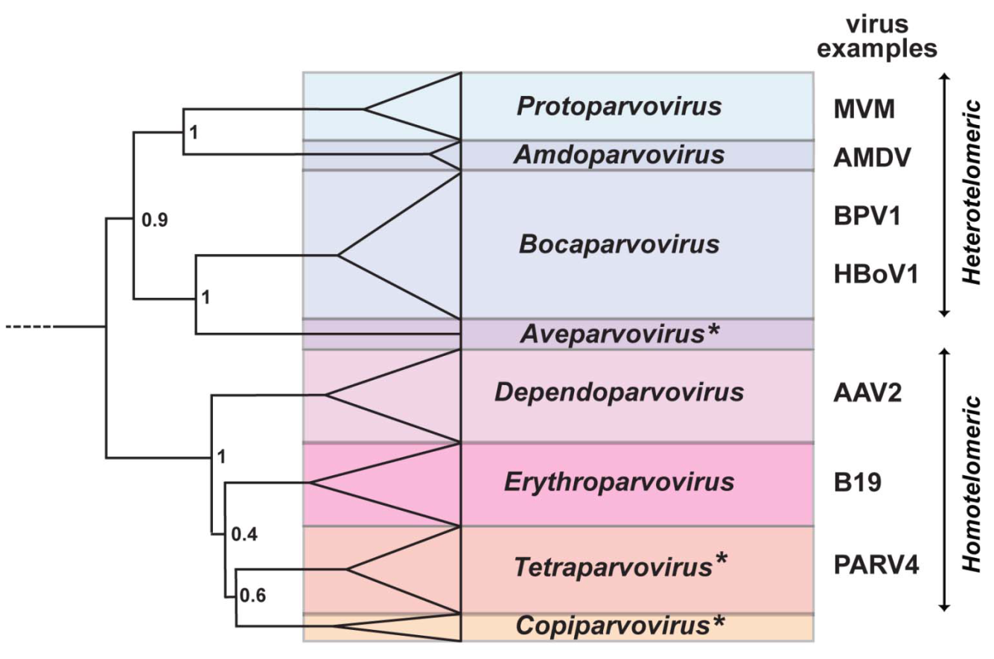
Notes:
The Parvovirinae subfamily. The genera of the Parvovirinae subfamily are depicted in a phylogenetic tree. Phylogenetic analysis is based on the amino acid sequence of the non-structural protein, NS1. The size of the color block for each genus indicates the relative number of species currently recognized, as an indicator of its diversity. Asterisks denote the names of new genera.

Slide 2
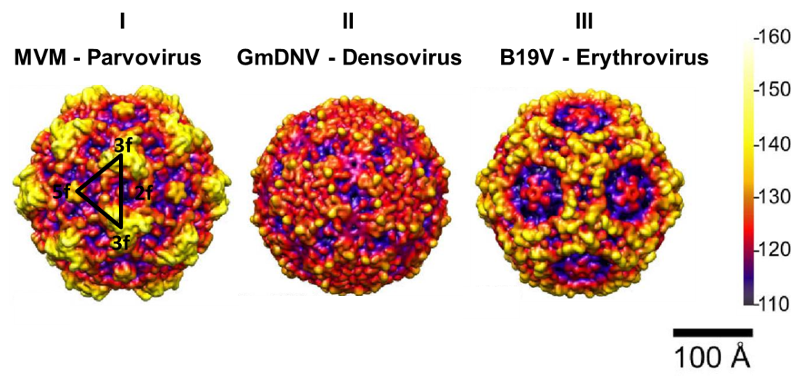
Notes:
Surface topology groups among members of the Parvoviridae family. Stereo, depth cued (blue-red-yellow-white) capsid surface illustration of representative members of the two subfamilies of the parvoviruses. The virus and the genus to which it belongs are indicated. A viral asymmetric unit bound (white triangle) is shown by a 2-fold (2f), two 3-folds (3f) and a 5-fold (5f) axis on the GmDNV image. A horizontal scale bar (100 Å) for diameter measurement and a vertical color bar depicting color cueing as a function of particle radius in Å are shown on the right hand side. These images were computed from atomic coordinates using the UCSF-Chimera program (ref), and all are rendered at the same resolution (7.9 A) and magnification. The figure was adapted from (ref.).

Slide 3
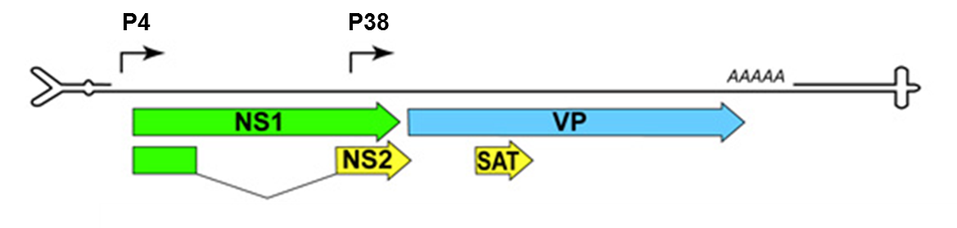
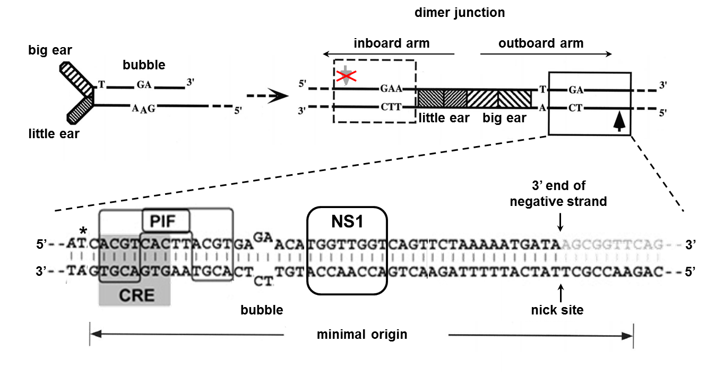
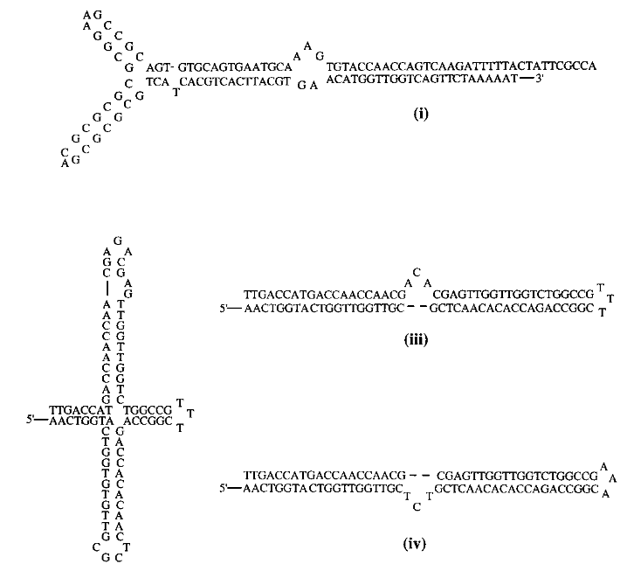
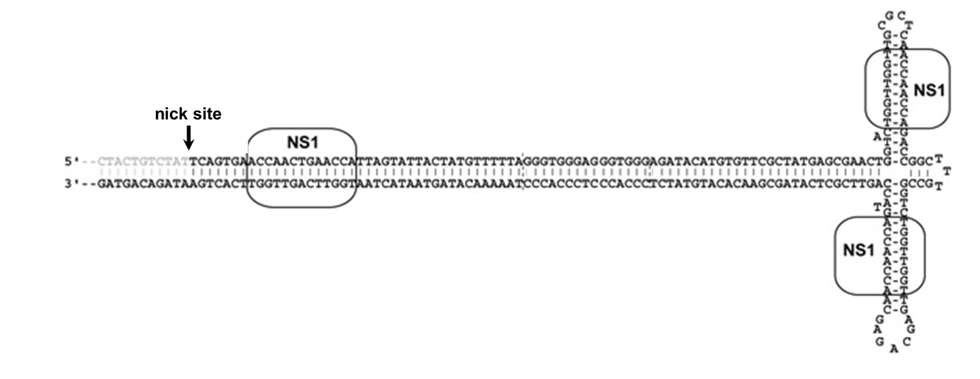
A
B
C
D
(i)
(ii)
(iii)
Notes:
Genome architecture of minute virus of mice (MVM).
The hairpins, drawn to represent their predicted structures, are scaled approximately 20x relative to the rest of the genome. Major open reading frames encoding proteins are represented by arrowed boxes and alternative RNA splicing for NS2 is indicated. Proteins are shaded green for the major replication initiator protein (NS1), blue for the structural (VP) proteins of the capsid, and yellow for sequences unique to the ancillary nonstructural proteins (NS2 also shares a common upstream intron with NS1). Transcriptional promoters, P4 and P38, are indicated by solid arrows and polyadenylation sites by the AAAAA-sequence block. Abbreviations: SAT, small alternatively translated protein.
The left-end hairpin of MVM and the dimer junction are shown in diagrammatic form. Asymmetries such as the ear structures, extra-helical T, and bubble sequence are indicated. The fully duplex, dimer junction, generated by rolling hairpin replication, is shown on the right. The short, palindromic sequences derived from the hairpin ears are represented by cross-hatched boxes.
Sequence details of the active left-end origin (approx. 50 bp) are shown, with an arrow indicating the active nick site. The minimal sequence required for origin activity is indicated by the double-headed arrow. Sequences of the bubble and the PIF, CRE, and NS1 binding sites are indicated. An asterisk represents the position of the extra-helical T, now base paired, and the gray box below it indicates the CRE consensus sequence.
Alternate conformations of the right-end hairpin sequences of MVM. The right-end terminus can form a hairpin structure in either the flip (i) of flop (ii) sequence orientation or a cruciform structure (iii).

